Slide 1

Budget Travel Scout
A multi-agent AI system that finds the best vibe vs. cost match for your next trip
Group 6 Simran Abhay Sinha Arav Pandey Savan Sangamesh Awanti

Slide 2
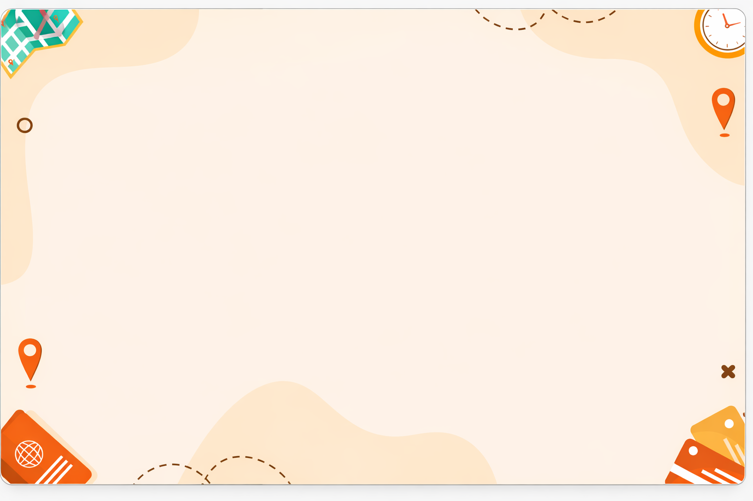
The Problem
Planning a budget trip is overwhelming
Flight Search, hotel hunt, and activity research are 3 separate tasks across many websites.
No single tool gives you a daily cost breakdown with a budget score
Genetic recommendation don’t match your specific interests
Travelers have no fast way to compare destinations by budget friendliness
3+
Hours avg. spend planning a weekend trip budget
10 s
Budget ravel Scout completes the same task in under 10 sec

Slide 3
Our Solution
A 3-agent AI pipeline that does it all at once
Enter your origin, destination, interest, budget, and trip duration - get a full report in seconds.
Origin + Destination
Agent A
Researcher
Agent B
Local Guide
Agent C
Budgeter
Full Report
+ Budget Score
A
Flight + Hotel Costs
GPT-4o + RAG-grounded estimates with price ranges and booking tips
B
Free Local Activities
3 curated activities matching your interest, sourced from scraped web data
C
Budget Breakdown
Daily total, budget score /10, over/under budget indicator, savings tips

Slide 4
Tech Stack
Built with production-grade tools
AI
OpenAI GPT – 4o
Powers all 3 agents — differentiated by system prompt, temperature, and task scope
RAG Pipeline BeautifulSoup scrapes Wikivoyage + travel blogs → SentenceTransformers embeds → ChromaDB stores and retrieves
Gradio Interactive web UI deployed temporarily
Google Colab Notebook
Fully documented, cell-by-cell walkthrough with markdown explanations
LLM GPT-4o · 3 instances · unique personas
Vector DB ChromaDB in-memory · cosine similarity
Embeddings all-MiniLM-L6-v2 (SentenceTransformers)
Scraping
BeautifulSoup · Wikivoyage + travel blogs
Deployment
Hugging Face Spaces · permanent URL
R
UI
NB

Slide 5
RAG Pipeline
Real web data, not just model guesses
When a user enters a destination, the system scrapes the web in real time and grounds LLM responses in actual travel content
🌐
Scrape
BeautifulSoup fetches Wikivoyage + Nomadic Matt blog for the destination
✂️
Chunk
Text split into 500-char overlapping chunks, deduplicated by MD5 hash
🧠
Embed
all-MiniLM-L6-v2 creates semantic vectors, stored in ChromaDB
🔍
Retrieve
Top-5 cosine-similar chunks passed as context to Agent A and Agent B
✨
Generate
GPT-4o produces grounded, specific answers — not generic

Slide 6
Agent Design
3 agents, distinct personas, sequential dependency
Agent A (Researcher) RAG Model: GPT-4o · Temperature: 0.2 Estimates round-trip flights and hotel costs per night. Budget-aware - flags if destination exceeds max daily budget.
Output: JSON with flight_low, flight_high, hotel_low, hotel_high, booking_tip
Agent B (Local Guide)
RAG Model: GPT-4o · Temperature: 0.3 Recommends 3 free or cheap activities matching the traveler's interest. On tight budgets, all activities must be Free.
Output: JSON array with name, description, cost, source
Agent C (Budgeter)
Model: GPT-4o · Temperature: 0.2 Synthesizes A + B outputs into a daily cost breakdown. Depends on both agents. Calculates total trip cost and budget score.
Output: daily totals, score/10, over_budget flag, savings_tips array
Agent C cannot run without A and B completing first — enforcing a real sequential dependency chain. All agents use JSON-structured output with fallback regex parsing for robustness.

Slide 7
Key Feature
Beyond the basic requirements
Budget constraint mode — set a max daily budget and get an over/under indicator with savings tips
Trip duration slider — adjusts flight amortization and total trip cost estimate across 1–30 days
RAG grounding — web scraping + vector retrieval gives destination-specific, real answers
Graceful fallbacks — every agent has try/catch + fallback data so the pipeline never crashes
Permanent deployment — live on Hugging Face Spaces, no expiry
10 interest categories including Architecture and Wildlife, beyond the original 8
Budget Friendliness 8/10
AGENT C OUTPUT EXAMPLE
Within Budget — $4618/day to spare
Daily total: $382 vs max: $5000 | Trip (6d): ~$2,520
Hotel
$100
Food
$50
Transport
$30
Flight
$192

Slide 8
Live Demo
Boston → Mumbai · Adventure · 6 days
A
Researcher · GPT-4o + RAG
Flight: $800–$1500 | Hotel: $50–$150/night
RAG: 5 web chunks indexed from Wikivoyage
Local Guide · GPT-4o + RAG
Marine Drive - Free
Sanjay Gandhi National Park - Free
Elephanta Caves - $5–$15
Budgeter · GPT-4o
Grand Daily Total: $382 Score: 8/10
Est. total trip (6d): ~$2,520
Budget Friendliness
8 / 10
B
Within Budget — $4618/day to spare Mumbai offers affordable accommodations and activities, making it a budget-friendly destination.
C

Slide 9
Engineering Decisions
Challenges solved along the way
4
JSON parsing robustness GPT-4o sometimes wraps responses in markdown fences or adds extra text. Added regex fallback parsing so every agent always returns valid structured data regardless.
Gemini API timeout in Colab Gemini 1.5 Flash was the intended model for Agent B but Colab's network blocked outbound Gemini API calls causing indefinite hangs. Replaced with GPT-4o using a higher temperature (0.3) and a Local Guide persona to differentiate it from Agent A.
Unicode SyntaxError in Colab Em dash characters (U+2014) copied into cell comments caused SyntaxError on Cell 2. Replaced all special characters with standard hyphens throughout the notebook.
1
OpenAI web_search_preview too slow The first approach used OpenAI's built-in web search tool. It caused 600-second timeouts in Colab. Replaced with a RAG pipeline (scrape → embed → retrieve) for faster, more controllable grounding.
Gradio.live 72-hour expiry The share=True link expires after 72 hours — not suitable for a graded submission. Deployed to Hugging Face Spaces for a permanent URL with API key secured via HF Secrets.
ChromaDB n_results crash Requesting more results than indexed documents caused hard errors. Fixed with a one-line clamp: safe_n = min(n_results, collection.count()).
5
2
3
6

Slide 10
Results
A fully working, permanently deployed multi-agent AI app
Thank you! · Questions welcome · Demo available at the link above
3
AI Agents
Sequential pipeline with real dependency chain
RAG
Web-grounded
Scrape → Embed → Retrieve → Generate
10s
Response time
Full pipeline completes in under 10 seconds
Live
GitHub
Link

